Slide 1

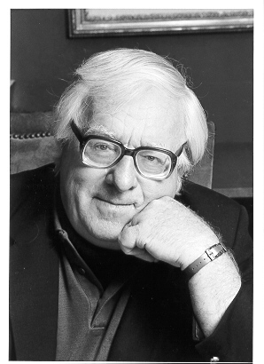
by Ray Bradbury

Slide 2
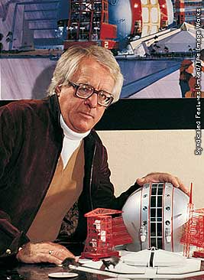
A Sound of Thunder
Meet the Writer
Most noted for his short stories, Ray Bradbury has also written novels, children’s books, plays, screenplays, television scripts, and poetry. His vivid imagination, lively style, and social commentary have set him apart in the world of fantasy and science-fiction writers.
Bradbury was born in Waukegan, Illinois, in 1920. His family moved to Los Angeles in 1934. He became interested in books and writing early in life.
Ray Bradbury

Slide 3
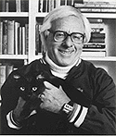
Ray Bradbury
Ray Bradbury is one of those rare individuals whose writing has changed the way people think. His more than five hundred published works -- short stories, novels, plays, screenplays, television scripts, and verse -- exemplify the American imagination at its most creative.
Once read, his words are never forgotten. His best-known and most beloved books, The Martian Chronicles, The Illustrated Man, Fahrenheit 451 and Something Wicked This Way Comes, are masterworks that readers carry with them over a lifetime. His timeless, constant appeal to audiences young and old has proven him to be one of the truly classic authors of the 20th Century -- and the 21st.
In recognition of his stature in the world of literature and the impact he has had on so many for so many years, Bradbury was awarded the National Book Foundation's 2000 Medal for Distinguished Contribution to American Letters, and the National Medal of Arts in 2004.

Slide 4





Ray Bradbury
Ray Bradbury calls himself a teller of tales and a magic realist. He also claims to remember everything – every book he’s ever read, every movie he’s seen, all the events of his life back to and including his birth, in Waukegan, Illinois, on August 22, 1920. All those memories and a big imagination are the materials for the fiction and poetry he’s been publishing for more than fifty years.

Slide 5
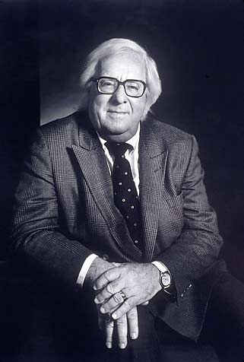
Ray Bradbury
Bradbury’s work is full of childhood imaginings, fantasies, and nightmares – portraits of Venus and Mars, time travel, ageless children, never-ending rains – but Bradbury the grown-up is a concerned citizen.
His fantasy stories are often warnings against blind faith in science, but they’re optimistic. By giving strange twists to everyday objects and events, Bradbury challenges his readers to look at them as if for the first time. As a writer he lets readers see science through the excited years of children, but he also informs, suggesting ways to use technology more responsibly.

Slide 6
Genre
A genre is a category or type of literature, such as fiction or poetry. Each genre can be subdivided into more specific categories that can be identified by subject matter, content, or style. Identifying the genre of a selection helps a reader to establish expectations for the work.
Readers can understand the genre of a literary work by analyzing its characteristics. As you read “A Sound of Thunder,” notice the clues that reveal the common elements of science fiction.

Slide 7
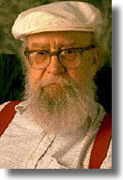
Elements of Science Fiction
Damon Knight, author, editor, critic, and founder of the Science Fiction Writers of America, once attempted to quantify the elements of science fiction.
He came up with the following list derived from a number of previously published formal definitions of science fiction:
  science
  technology and invention
  the future and the remote past, including all time travel stories
  extrapolation (speculation based on signs or omens)
  scientific method
  other places--planets, dimensions, etc., including visitors from the above
  catastrophes, natural or manmade
Knight concluded that a story with at least three of the above elements is generally perceived to be science fiction; stories with two elements were borderline; stories with one or no elements were not science fiction.
Damon Knight

Slide 8
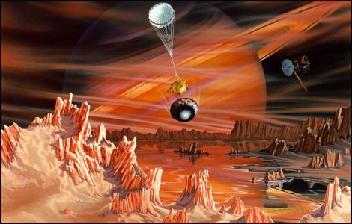
Science Fiction
Although the term science fiction was not used until about 1930, science fiction tales have been told since before the invention of writing. One of the earliest science fiction writers was Lucian of Samosata who, around 100 BC, wrote a fantasy about a journey to the moon. Modern science fiction began to take shape in the nineteenth century.

Slide 9
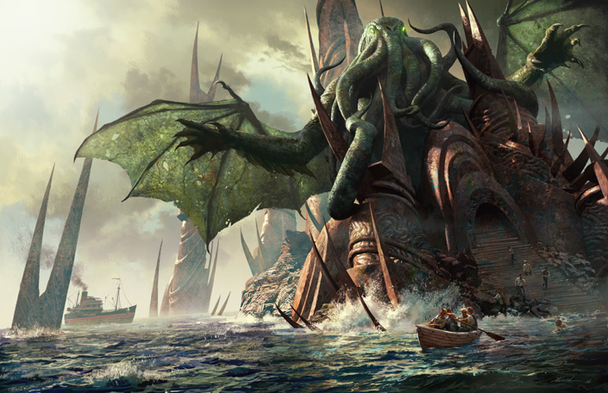
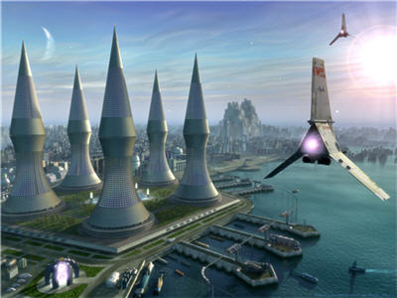
Science Fiction
Science fiction is defined loosely as fiction that deals with the impact of science and technology on the world. Sometimes the technology is real, sometimes it is entirely imagined, and sometimes it has been imagined by an author and then brought to reality by scientists. Science fiction themes often warn of the potential for disaster when technology is abused.

Slide 10
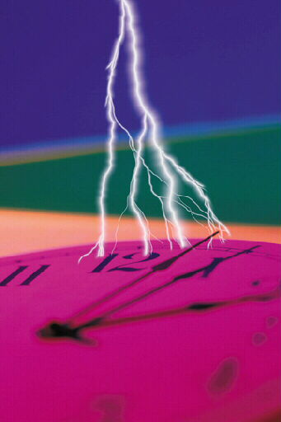

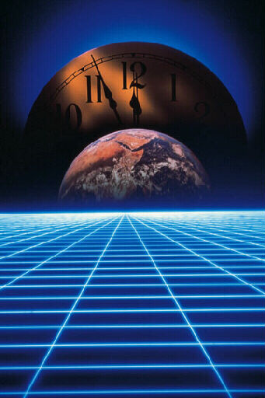
A Sound of Thunder by Ray Bradbury
“Who controls the past controls the future.”
—George Orwell

Slide 11
A Sound of Thunder
In the following short story, Ray Bradbury implies that seemingly insignificant actions can change the future for an entire generation.
Before you read the story, think about the following questions:
  How might your actions during your lifetime affect someone living one hundred years in the future?
  Do you believe that you have a responsibility to future generations?

Slide 12
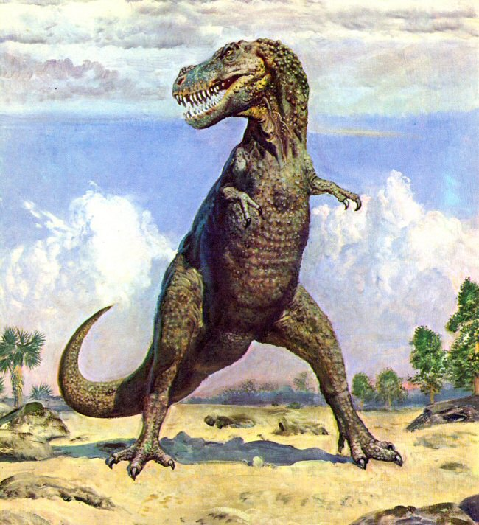
A Sound of Thunder
Introducing the Story
It’s the year 2055. Eckels, a wealthy hunter, wants to travel back in time to shoot a ferocious dinosaur. But he gets in over his head when he books passage with Time Safari, Inc.
  This story explores the possibility that even tiny changes to the environment of the past can drastically alter the future.

Slide 13
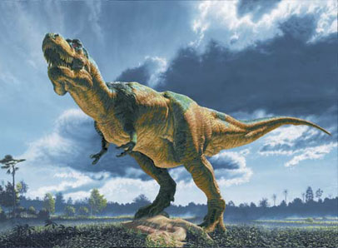
Tyrannosaurus Rex
The Tyrannosaurus rex lived during the late Cretaceous Period, between 97 and 66 million years ago. Scientists estimate its length at about 40 to 50 feet, its height at about 15 to 20 feet, and its weight at about 5 to 7 tons.
The dinosaur’s open mouth revealed frighteningly sharp six-inch-long teeth with serrated edges.

Slide 14

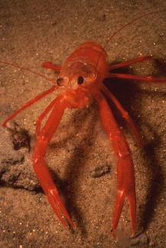

A Sound of Thunder
Introducing the Story
T-rex lived during the late Cretaceous Period. What other life forms were around then?
insects similar
to today’s
the first
flowering plants
marine
invertebrates

Slide 15

A Sound of Thunder
Literary Focus: Style
Ray Bradbury tells this science-fiction story in a lush style.
  He uses vivid images
  and imaginative figurative language to create an exotic setting.
  The setting and the figurative language shape a tense and suspenseful mood, or atmosphere.

Slide 16
A Sound of Thunder
Literary Focus: Style
As you read “A Sound of Thunder,” notice the elements of Bradbury’s style.
  Diction and sentence patterns: How do they create a distinctive writing style?
  Images: Which of your senses do they appeal to? What feelings do they evoke for you?
  Figurative language: How does it help create the setting? the mood?

Slide 17
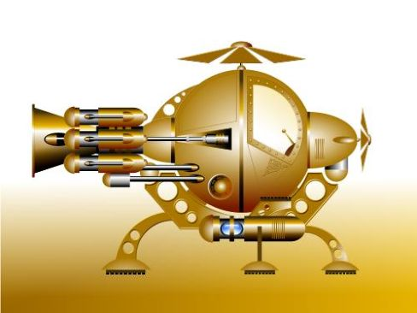

A Sound of Thunder
Reading Skills: Cause and Effect
The plot of “A Sound of Thunder” is based on a theoretical cause-and-effect chain that might look something like this:
Time-traveling
human steps on
butterfly in past.
Butterfly
population
declines.
Entire
ecosystem
is upset.
Humans evolve
in different
environment.
Modern
civilization
is altered.

Slide 18
A Sound of Thunder
Summary
This science fiction story begins in the year 2055, the day after an election in which Keith, a democrat, wins out over Deutscher, a fascist. Time travel is possible and Eckels, a wealthy hunter, goes, goes on a prehistoric safari to shoot a dinosaur.
As Eckels’s party travels back in time, Travis, the leader, warns the hunters not to stray from a prelaid anti-gravity Path, theorizing that the minutest damage to the environment could have serious reverberations for the future.

Slide 19
A Sound of Thunder
Summary
Even the tyrannosaur they are going to shoot is chosen because it would have died minutes later anyway. When the time comes to make the kill, Eckels panics and runs away, stumbling off the Path. Travis is furious.
After the party returns to 2055, Eckels senses that things are subtly different. He then discovers a dead butterfly on the sole of his shoe. After
After finding out that now Deutscher has triumphed over Keith, Eckels realizes the magnitude of his actions – he has changed the course of his country’s history. The story’s climax comes when Travis shoots Eckels.

Slide 20
This powerpoint was kindly donated to www.worldofteaching.com
http://www.worldofteaching.com is home to over a thousand powerpoints submitted by teachers. This is a completely free site and requires no registration. Please visit and I hope it will help in your teaching.

